Slide 1

Advanced Flight Booking System
This presentation will showcase the features and functionalities of an advanced flight booking system designed to provide a seamless and efficient user experience.

Slide 2
Core Components
Flight Data
Search and Booking
The system stores flight information in a structured format, including flight ID, source, destination, departure time, total seats, available seats, and price. This data is efficiently managed using a combination of data structures.
Users can search for flights based on source, destination, and maximum price. The system prioritizes available flights and sorts them by price, providing a user-friendly search experience.

Slide 3
Data Structures
1
Flight Map
2
Route Map
3
AVL Tree
A hash map efficiently stores flight information, allowing for quick access and retrieval based on flight ID.
Another hash map organizes flights by route, enabling efficient search based on source and destination.
An AVL tree is used to store flights sorted by price, facilitating efficient search for flights within a specified price range.

Slide 4
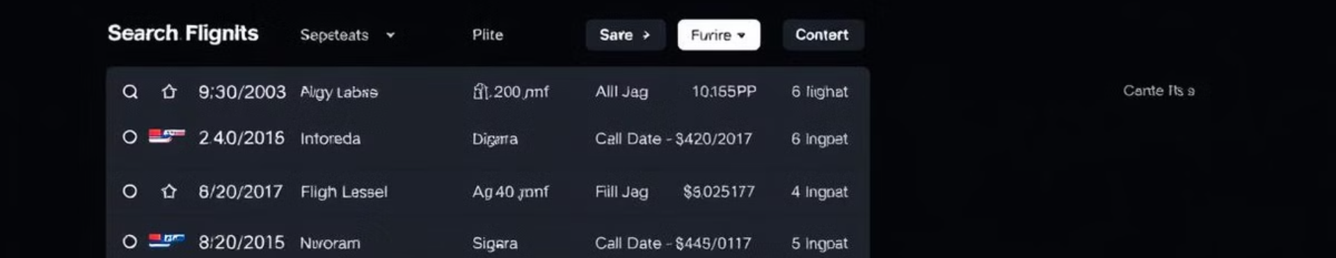


Search Functionality
Route Search
Price Range Filter
The system allows users to search for flights based on their desired source and destination cities.
Users can specify a maximum price to narrow down their search results to flights within their budget.

Slide 5
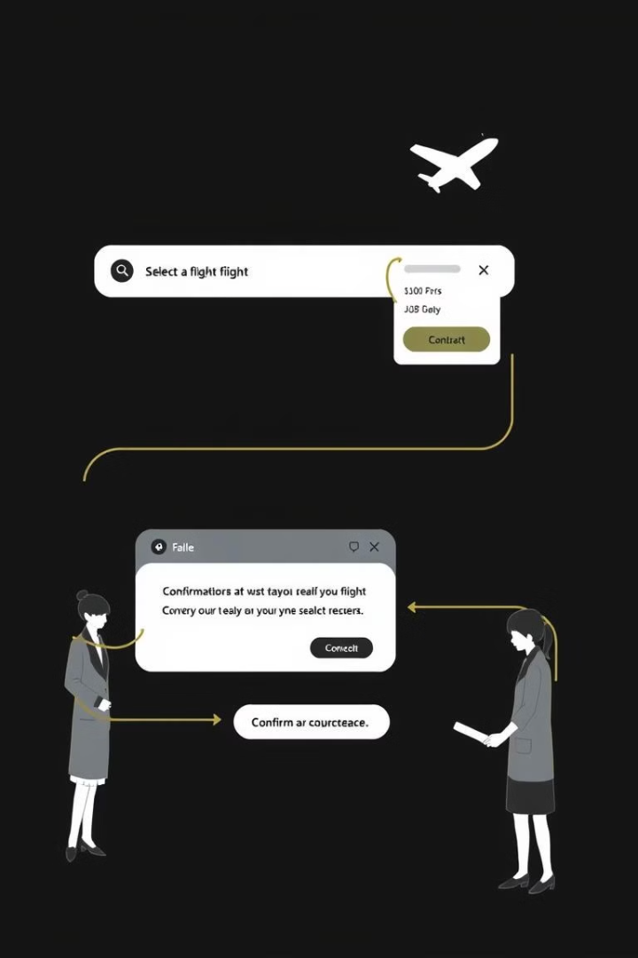
Booking Process
1
Flight Selection
Users choose a flight from the search results based on their preferences and availability.
2
Booking Confirmation
The system confirms the booking and updates the flight's available seats, notifying the user of the successful booking.
3
Waiting List
If the flight is full, the system adds the passenger to a waiting list, notifying them of their position and potential availability.

Slide 6
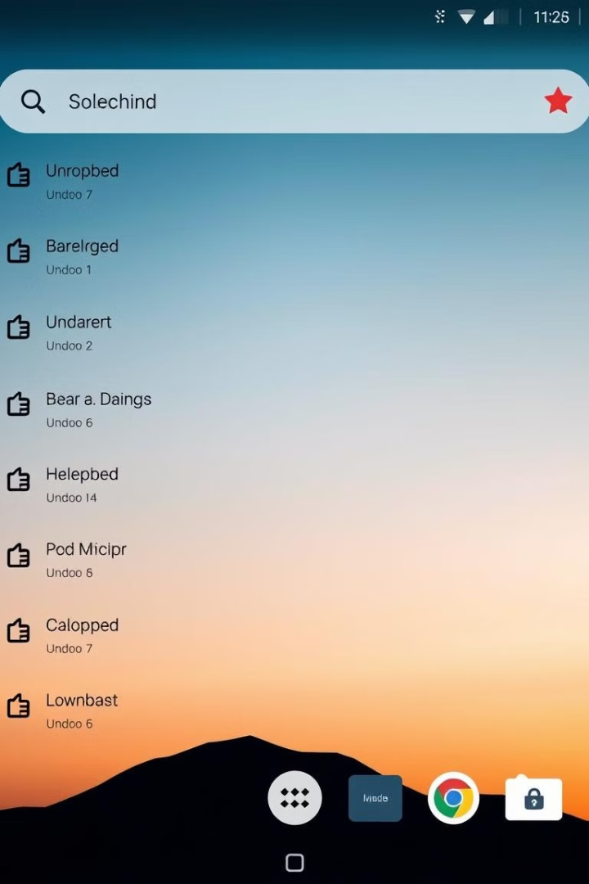


System Enhancements
Notifications
The system sends notifications to users about new flight additions, booking confirmations, and waiting list updates, keeping users informed.
Recent Searches
The system stores recent searches, allowing users to quickly access previously searched routes and avoid repetitive searches.

Slide 7
Future Enhancements
Graphical User Interface and real-time updates.
Implement real-time flight tracking, providing users with up-to-the-minute flight status.
Develop personalized recommendations based on user preferences and historical data.
Enhance security measures to protect user data and prevent fraudulent activities.
Use database to store record of users and flights.

Slide 8

Conclusion
This advanced flight booking system offers a comprehensive solution for managing flight information, facilitating efficient search and booking processes, and enhancing user experience through various features and functionalities. The system's robust design and innovative features make it a valuable tool for both airlines and passengers.

Slide 9
THANK YOU

